Slide 1
Global Harmonization System (GHS)
Hazard Communication Training
3E Protect

Slide 2
Global Harmonization System (GHS) Hazard Communication Program
OSHA (29 CFR 1910.1200)
Employee Right-To-Know

Slide 3

Training Objectives
OSHA Hazardous Communication Standard
Hazardous Material Identification
Labeling
Safety Data Sheets
Proper Handling of Hazardous Materials
Personal Protective Equipment
Notes:
After completing this hazardous materials training program, you will have a better understanding of:
The OSHA Hazard Communication Standard
Chemical hazard identification in the workplace
Various types of labels, other forms of warnings and applicable standards
Safety Data Sheets (previously Material Safety Data Sheets) and the pertinent information they contain.
The proper handling considerations of hazardous materials to minimize exposure and personal protection equipment required in these situations.

Slide 4
Regulation Review
1970: Occupational Health and Safety Act
Established Federal Occupational Health and Safety Administration (OSHA)
1983: Hazard Communication Standard (Original)
Applicable to employees of manufacturing companies
Required employers to inform employees of workplace hazards
1987: Hazard Communication Standard (Revised)
Expanded scope to apply to all businesses
2012: OSHA Adopts Global Harmonized System
Adoption of United Nation’s global standard initiative
Notes:
The Federal Occupational Health and Safety Administration (OSHA) was established in 1970 to carry out the Occupational Safety and Health Act.
The purpose of the act was to: “...to assure so far as possible every working man and woman in the nation safe and healthful working conditions and to preserve our human resources.”
In 1983 The US Dept. of Labor and OSHA passed the original Hazard Communication Standard (HCS), which only applies to employees of manufacturing companies. This regulation required that employers inform their employees of the chemical hazards that may be present in the workplace. In 1987, OSHA expanded the scope to apply to all business.
In 2012, OSHA adopted the United Nations initiative to develop global standard for classification and communication of chemical hazards, the Global Harmonization System (GHS) has been accepted by the Occupational Safety and Health’s HCS program.

Slide 5




OSHA HazCom Program Requirements
Written Program
Chemical Inventory
Labeling
Safety Data Sheets
Training
Notes:
OSHA requires companies to have a written Program that describes the chemical hazards in the workplace and identifies how employees are to be informed about these hazards.
This written program includes:
A list of all hazardous materials (chemical inventory)
Guidelines on how products are to be labeled
Safety Data Sheet management and unrestricted employee access to Safety Data Sheet
Employee Training

Slide 6
Hazard Categories: CIRT
Corrosive
Ignitable
Reactive
Toxic
Notes:
Hazardous materials include common and uncommon materials used throughout our homes, manufacturing processes, service and maintenance industries, etc. We use many hazardous materials throughout our operations.
The acronym CIRT is often used to identify the four general hazard categories: Corrosive, Ignitable, Reactive and toxic.
Hazardous materials include the following:
Adhesives, Lubricants, Aerosol , Paints, Solvents, Gasoline & Diesel Fuels, Cleaners, Disinfectants, Compressed Gases, Welding Rods , and many, many more… as you can imagine we use many hazardous materials in our operations.

Slide 7
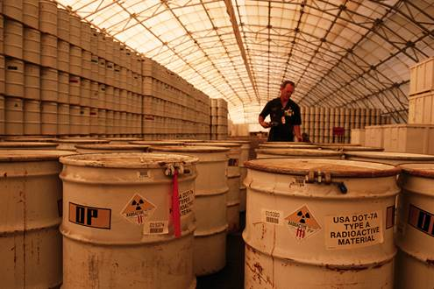
Hazardous Materials Types
A Hazardous Material is any material that because of its quantity, concentration, physical or chemical characteristics, poses a present or potential hazard to human health or the environment.
Chemical
Physical
Health

Slide 8


Physical Hazards
Physical
Ignitability
Reactivity
Explosive
Corrosive
Notes:
Physical Hazards: a chemical that is either ignitable, reactive, explosive, an oxidizer, corrosive, flammable solid, pyrophoric – air reactive, water reactive, or a compressed gas has a physical hazard. Examples of some products that can present physical hazards include gasoline, propane to run machinery, forklifts, and welding gases.
Let’s review some physical hazards.

Slide 9
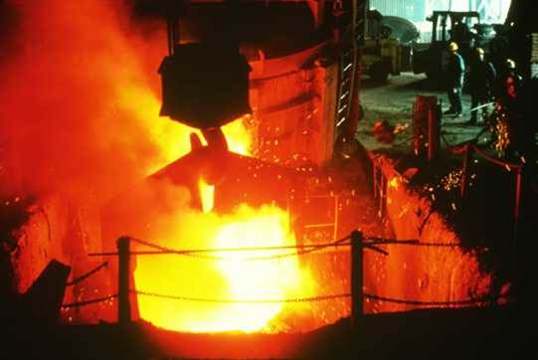
Ignitable
FLASH POINT
The point at which a vapor may ignite
> 100 Degrees → Combustible
< 100 Degrees → Flammable
Notes:
Ignitable:
The flash point in the minimum temperature at which a chemical emits a vapor that may ignite with a source of ignition, such as a spark or flame. Based on the products flash point the products is either a Combustible or Flammable.
Combustible products have a flash point between 100 and 200 Degrees Fahrenheit, examples of combustible materials include paint thinner, kerosene and lubricating oil.
Flammable products have a flash point below 100 Degrees Fahrenheit, examples of flammable materials include gasoline, natural gas, acetone.

Slide 10


Reactive
Reacts violently
May support combustion
Releases toxic gas
Examples:
Calcium hypochlorite (Shock)
Hydrogen peroxide
Notes:
Oxidizers are chemicals that promote combustion in other materials.
Examples of Oxidizers include Calcium hypochlorite (pool chlorine tablets and powder) and hydrogen peroxide.

Slide 11
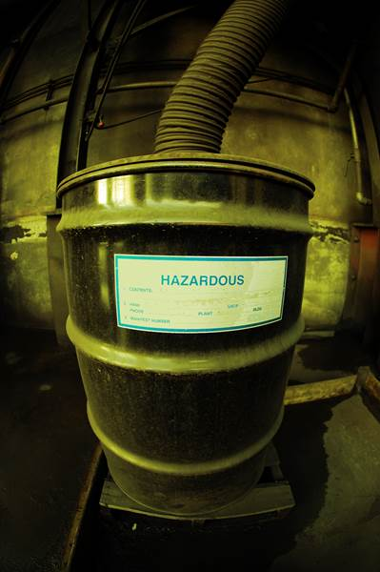


Health Hazards/Affect to Body
Health
Chronic
Affect to Body
Acute
Hazards
Target Organ Effects
Carcinogens
Sensitizers
Irritant
Corrosive
Toxic
Notes:
Health Hazards: examples of health hazards include carcinogen, toxic, irritant, corrosive, target organ effects, sensitizer. Health hazards are also identified as their health affect to the body, acute or chronic health effect.
Acute: effects occur quickly and usually are the result of short-term exposure. The burning sensation caused by getting drain opener on skin is an acute effect.
Chronic: effects generally take longer to occur and are usually the result of long-term exposure. For example, long term exposure to some chemicals known as carcinogens, may cause cancer.

Slide 12
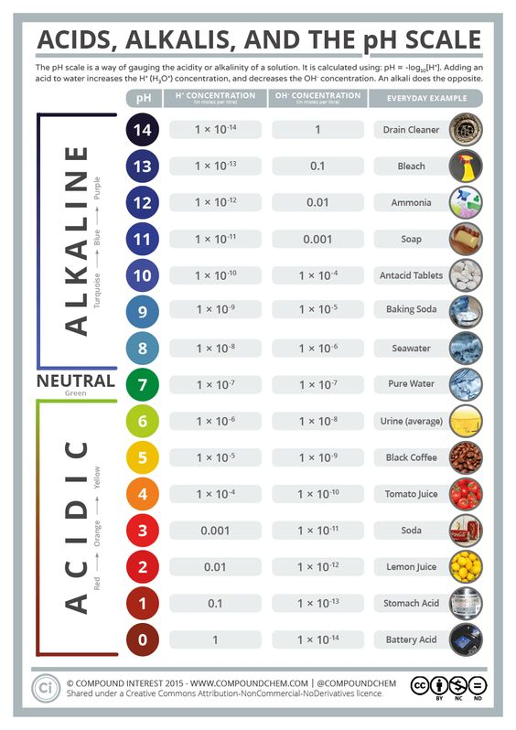

Corrosives
BASES
Sodium hydroxide
Sodium hypochlorite
ACIDS
Muriatic acid
Sulfuric acid
Notes:
Corrosive: A substance that causes visible destruction or irreversible damage to living tissue. This destruction is caused by chemical reaction at the site of the contact (skin, eyes or lung tissue), this would be the health hazard. As we may also know corrosive material can also cause destruction to metal, this would be the physical hazard. This is an example of how hazardous materials may have a physical and health hazard.
Based on the pH scale of 0-14. The lower the number the more acetic the material is. The higher the number the number the more basic the material is. pH of 7 is neutral.
Example of a corrosive Acid material can be: Battery (Sulfuric) Acid
Example of a corrosive Base material can be: Drain Opener – Lye or Caustic Soda

Slide 13
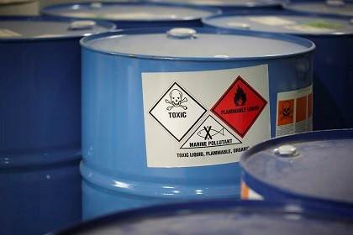


Toxic
Can cause adverse health affects to the body
Central nervous system
Target organs
Examples: pesticides, acids, paint strippers, solvents
Notes:
Toxic: A substance that can cause damage or disturbance to bodily functions when it enters the body.
Examples: Pesticides, Acids, Paint Strippers & Solvents

Slide 14



Exposure Standards
Occupational Health and Safety Administration
Developed Permissible Exposure Limit (PEL)
PEL is the legally enforceable maximum level
American Conference of Governmental Industrial Hygienists
Defined Threshold Limit Values (TLV) for up to 800 substances
TLV identifies maximum exposure levels
National Institute for Occupational Safety and Health
Established Recommended Exposure Limits(REL)
REL are transmitted to OSHA and the Mine Safety and Health Administration (MSHA).
Notes:
Regulatory authorities develop standards for the acceptable levels of chemical exposure that are thought to be safe with no injury or illness.
OSHA developed the enforceable maximum level identified as Permissible Exposure Limits (PEL)
ACGIH has set recommended maximum exposure levels identified as Threshold Limit Values (TLVs)
NIOSH worked in conjunction with OSHA to develop Recommended Exposure Limits (REL) and develop health and safety standards for substances.

Slide 15
Other Hazards
Carbon Monoxide:
An odorless, colorless gas that is produced from the incomplete combustion of fuels (propane, gasoline).
Sulfuric Acid/Hydrogen Gas:
Commonly used in batteries and drain openers. It is a powerful acid that is very corrosive and emits a pungent odor. If spilled, it can cause violent reactions and hazardous fumes. Under some conditions, acid filled batteries may release flammable hydrogen.
Blood-borne Pathogens:
Are microorganisms in the blood that can cause disease. These pathogens include, but are not limited to, the hepatitis B virus (HBV) and the human immunodeficiency virus (HIV).
Confined Space Entry:
The potential for a hazard exists when entering small spaces or rooms, that are not well ventilated, when chemical vapors are present.
Notes:
To work safely in the work place it is important to pay attention to other hazards that may exist. The following are examples of potential Other Hazards.
Carbon Monoxide: Odorless, colorless gas produced by the incomplete burning of fuels (propane, gasoline).
Sulfuric Acid/Hydrogen Gas: Industrial batteries for forklifts, pallet jacks, etc. contain batteries that have sulfuric acid. Under some situations these batteries my release hydrogen gas that can cause a potential fire situation and other health effects.
Blood-borne Pathogens: Blood-borne pathogens are microorganisms that if in the blood has the potential cause disease.
Confined Space Entry: Confined Space company policy must be followed for all confined space entry.

Slide 16




Routes of Entry
Absorption
Ingestion
Inhalation
Injection
Notes:
Absorption
Many chemicals can be absorbed directly through the skin. Although your skin acts as a natural protection barrier, solvents (such as paint thinners, alcohol and components in adhesives and insecticides) will dissolve the oils in your skin and pass directly through to your blood stream. Your best protection against accidental absorption is to never handle a spilled or leaking container of any kind without gloves and eye protection. Wash your hands frequently if you are involved in the handling of any hazardous chemicals. Soap and water are the best response to contamination of the skin.
Inhalation
Exposure can occur while using a product, such as using mineral spirits after painting, or cleaning up a spill of hazardous liquids. Should you be exposed to any product that irritates your nose, mouth, or lungs, get away quickly or stop using the product. You may need to wear personal protective equipment when working with hazardous materials if the area cannot be adequately ventilated.
Ingestion
While it may seem unlikely, ingestion of hazardous chemicals is quite possible. For example, if you do not wash your hands thoroughly after handling chemicals, the chemicals can be transferred from your hands to food and from the food to your mouth. If you handle chemicals, you must wash your hands frequently throughout the day and make a conscious effort to keep your hands away from your mouth.
Injection
Although injection with a hazardous material may also seem unlikely, it is possible. Injection is the ability for chemicals to enter the body through cuts, sores or other open wounds. An example is being cut while cleaning up contaminated broken glass.

Slide 17
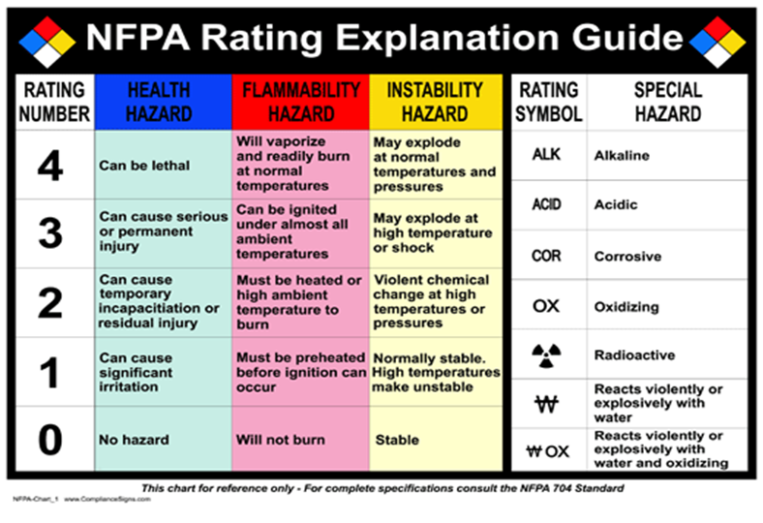
Labeling: National Fire Protection Association (NFPA)
Notes:
Manufacturers or distributors must label all chemical containers before the chemical package leaves their facility. The labels on incoming materials should not be changed or removed. If a product enters your facility without proper labeling, notify your supervisor. Materials that do not have proper warning labels must not be used until proper labels are obtained.
If chemicals are placed in another container, this new container must have a label placed on it.
National Fire Protection Labeling System
The National Fire Protection Association has a labeling system that identifies the hazard class of a material to aid firefighters and others. The rating system is displayed in a diamond that is divided into four color-coded areas. The hazard classes and their related color codes are:
Blue = Health: The capacity of a material, upon contact, to cause personal injury
Red = Flammability: The degree of fire risk associated with a material.
Yellow = Reactivity: The likelihood that a material will react violently with another material
White = Specific Hazard: This could include identification of oxidizers, acids, water reactive materials, etc.
Numbers 0 thru 4. 0=No hazard 4=Highest hazard

Slide 18
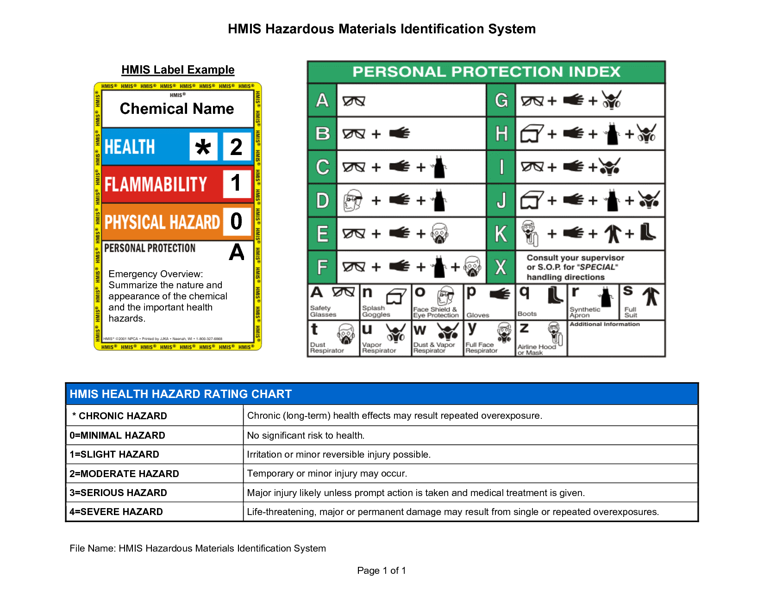
Labeling: Hazardous Materials Identification System (HMIS)
Notes:
The HMIS system is like the National Fire Protection Association system. HMIS stands for Hazardous Material Identification System, and the system uses the same hazard classes and color identification system as the NFPA system. The white portion of the HMIS label contains the required Personal Protective Equipment needed to work with the product.

Slide 19
Consumer Product Signal Words
TOXIC
POISON
REACTIVE
DANGER
MAY CAUSE IRRITATION
Sensitizer
Notes:
The Consumer Product Safety Commission has specific labeling requirements for consumer or household type products. The easiest way to recognize a hazardous product is to read the label. Products should be considered hazardous if any of the following words or phrases appear on the container or label:
Danger Irritant Flammable Harmful if inhaled Warning Sensitizer Combustible May cause irritation Caution Reactive Corrosive Causes eye injury Hazard Carcinogen Poison Fatal if swallowed Toxic Oxidizer Radioactive

Slide 20




Department of Transportation (DOT)
Notes:
Hazardous materials must be properly packaged, marked and labeled before being offered for transport. Hazardous materials are typically already packed, marked and labeled in accordance with federal DOT regulations by the manufacturer prior to being shipped.

Slide 21
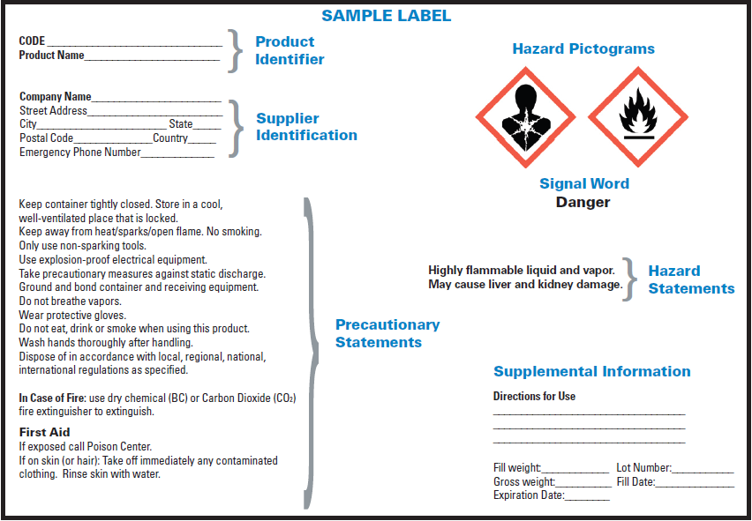
Global Harmonization Label (GHS)
Product Identifier
Signal Word
Hazard Statement
Precautionary Statements
Supplier Information
Pictograms
Notes:
With the adoption of the GHS standardization , GHS compliant labels will also be used to identify containers. These labels will require Product Identifier, Pictograms, Supplier information, Signal Word, Hazard Statement, Precautionary Statement(s).

Slide 22

GHS Pictograms
Pictogram
Description
Examples
Health Hazards: Substances known to be carcinogens, mutagens or reproductive toxins or adversely impact the lungs or other vital organs
Health Hazard
Lead-acid Batteries
Anti-seize Lubricants
Loctite Adhesive
Printer Toner
Classification | Category
Carcinogen | 1A, 1B, 2
Germ Cell Mutagenicity | 1A, 1B, 2
Reproductive Toxicity | 1A, 1B, 2
Respiratory Sensitizer | 1A, 1B
Target Organ Toxicity | Single: 1, 2, 3 Repeated: 1,2
Aspiration Hazard | 1

Slide 23

GHS Pictograms
Pictogram
Description
Examples
Flammable: Volatile material that at a specific flashpoint will vaporize to form an ignitable mixture.
Flame
Fuels
Lubricants
Paint thinners, spray paints
Hair spray
Shoe polish
Classification | Category
Flammable Gases | 1, 2
Flammable Aerosols | 1, 2
Flammable Liquids | 1, 2, 3, 4
Flammable Solids | 1, 2
Pyrophorics (liquids and solids) | 1
Self-heating substances | 1, 2
Self- reactive substances | A to G
Organic Peroxides | A to G

Slide 24

GHS Pictograms
Pictogram
Description
Examples
Harmful Health Effects: Harmful effects due to chemical exposure that generally result in temporary, yet serious, adverse health effects (irritation to skin, eyes, difficulty breathing)
Exclamation Mark
Room Deodorizers
Rubber Gloves
Antibacterial Soaps
Hair Dyes
Classification | Category
Skin Irritant | 1A, 1B, 1C, 2
Eye Irritant | 1, 2A, 2B
Skin Sensitization | 1A, 1B
Acute Toxicity | 1, 2, 3, 4
Narcotic Effects
Respiratory Tract Irritation

Slide 25

GHS Pictograms
Pictogram
Description
Examples
Pressurized Gas: Gases in a pressurized, compressed, liquefied, refrigerated, or dissolved state
Gas Cylinder
Propane
R22 Refrigerant
Compressed Air
Compressed Natural Gas
Classification | Criteria
Gases Under Pressure | 1
Compressed Gas | Gaseous at -50°C
Liquefied Gases | Partially liquid at temp > -50°C
Refrigerated Liquefied Gases | Partially liquid (low temp)
Dissolved Gases | liquid phase solvent

Slide 26

GHS Pictograms
Pictogram
Description
Examples
Corrosive Materials: Substances that have the power to cause irreversible damage or destroy another substance, to include human skin and organs, by contact.
Corrosion
Acid-based cleaners
Sulfuric acid
Paint strippers
Plumbing products (Drano)
Toilet bowel cleaners
Hair removal products
Classification | Category
Skin Corrosion or Burns | 1A, 1B, 1C, 2
Eye Damage | 1, 2A, 2B
Corrosive to Metal | 1

Slide 27

GHS Pictograms
Pictogram
Description
Examples
Explosion Hazard: Volatile material that at a specific flashpoint will vaporize to form an ignitable mixture.
Exploding Bomb
Fertilizers
Munitions
Carpet cleaners
Caulking compounds
MEKP (polymer catalyst)
Classification | Category
Explosives | 1.1, 1.2, 1.3 1.4, 1.5, 1.6
Self-Reactive Substances | A to G
Organic Peroxides | A to G

Slide 28

GHS Pictograms
Pictogram
Description
Examples
Oxidizers: A chemical compound that is not necessarily combustible, but may, by transferring oxygen, cause or contribute to the combustion of other material.
Flame Over Circle
Ferric Salts – used in odor control products, water and waste water treatment and coagulants
Industrial and household disinfectants
Chlorine-based products
Classification | Category
Oxidizing Gases | 1
Oxidizing Liquids | 1, 2, 3
Oxidizing Solids | 1, 2, 3

Slide 29

GHS Pictograms
Pictogram
Description
Environmental Effects : Substances know to produce toxic effects in marine life. Could also be used generically for other specified environmental hazards. (Optional for U.S.)
Environment

Slide 30

GHS Pictograms
Pictogram
Description
Examples
Acute Toxicity: Fatal or toxic effects, up to and including death from exposure to a substance that results either from a single exposure or multiple exposures in a short space of time (usually less than 24 hours).
Skull and Crossbones
Household/Industrial Bleach
Diesel fuels
Acetone
Pesticides
Brake dust dissolvent/cleaner
Oven cleaner
Cleaner cocktails
Classification | Category
Acute Toxicity | 1, 2, 3, 4
Oral | 1, 2, 3, 4
Dermal | 1, 2, 3, 4
Inhalation | 1, 2, 3, 4

Slide 31
Safety Data Sheets
Integral component of Hazard Communication Program
Provided by the manufacturer
GHS standardization includes 16 sections
Must validate document revision within local country’s specified timeframe
Must be available 24-7-365
Notes:
You have access to an important source of information, a Safety Data Sheet (SDS).
The SDS is prepared by the manufacturer and contains very detailed information about the product identification, hazards, ingredients, safe handling, emergency procedures, etc for each hazardous material in the workplace.
With the adoption of the Global Harmonization System (GHS) the Material Safety Data Sheet (MSDS) name has been changed to Safety Data Sheet (SDS) to align to how they are referred to internationally. Also, a requirement to the SDS is a standard 16 section format. The transition period for compliance with all modified parts of the HazCom Standard is June 2015. The MSDS name and the 16 section format will be changed by manufacturers during this timeframe.
An objective of the HazCom program is to ensure that all employees are aware of the information contained within an SDS and the availability of these documents.
Within the GHS training manual is a GHS compliant SDS for your review.
The following are the required sixteen sections of an SDS:
1) Identification 2) Hazard(s) identification 3) Composition/information on ingredients 4) First-aid measures 5) Fire-fighting measures 6) Accidental release measures 7) Handling and storage 8) Exposure controls/personal protection 9) Physical and chemical properties 10) Stability and reactivity 11) Toxicological information 12) Ecological information 13) Disposal consideration 14) Transport information
15) Regulatory information 16) Other information, including date of preparation or last revision
SDS information is maintained by 3E & is available 24 hours per day, 7 days a week.

Slide 32
GHS Safety Data Sheets: Required Sections
As Prescribed in
Appendix D
and 1910.1200
Identification
Hazard(s) identification
Composition/information on ingredients
First-aid measures
Fire-fighting measures
Accidental release measures
Handling and storage
Exposure controls/personal protection
Physical and chemical properties
Stability and reactivity
Toxicological information
Ecological information*
Disposal considerations*
Transport information*
Regulatory information*
Other information including prep/rev date
12-15 are out of OSHA’s jurisdiction

Slide 33
Presence of Hazardous Materials
Do you work with hazardous materials?
Do products/packages have the appropriate labels?
Are there any charging devices on site? (i.e., forklift battery charging station?)
Are incoming and/or outgoing trucks placarded appropriately?
Are lockers available to store hazardous materials?
Notes:
Being familiar with the hazardous materials present in your work area is the best way to proactively protect your safety and health. If you handle hazardous materials, you must follow safety precautions. By following these precautions, you can reduce the risk of accidental exposure and spills.
Think about your operations. Do you work with any chemicals?
Do products/packages have warning or identification labels such as DOT, NFPA, HMIS or consumer product labeling?
Do you have flammable cabinets in your area?

Slide 34

Handling Hazardous Materials
Never leave containers open
Never mix chemicals unless specified by the manufacturer
Use adequate ventilation when required
Always follow product label instructions
Read the Safety Data Sheet prior to using the material
Always use appropriate personal protective equipment
Notes:
Following these steps will help everyone maintain a safe workplace:
Never leave containers open, close containers immediately after use.
Never mix any chemicals together unless otherwise specified by the manufacturer.
Follow all instructions on the product label.
Read the Safety Data Sheet.
Use chemicals for their intended purposes only.
Always wear appropriate proper personal protective equipment when using or handling chemicals.
Have a Spill Kit available in areas that contain hazardous materials and be trained in the use of the kit.

Slide 35

Personal Protective Equipment
Use only approved Personal Protective Equipment
Be safety conscious
Handle materials carefully
Never use unlabeled materials
Maintain good personal hygiene
Notes:
Personal Protective Equipment (PPE) is available to help employees protect themselves from the dangers posed by chemicals. There are many types of PPE ranging from fully encapsulating chemically resistant suits to rubber/neoprene gloves designed to keep your hands clean. Employees must be trained to properly use any PPE, but some types of equipment such as respirators require extensive training with annual refresher training.
Always wear proper personal protective equipment when using or handling chemicals.

Slide 36
Review
Identify hazardous materials in the workplace
Be familiar with the OSHA Hazard Communication Standard
Know how to access, read and understand Safety Data Sheet (SDS)
Know the different types of labels and warnings found on products and packages
Understand how to minimize exposure
Report any hazardous materials problems or concerns to your supervisor
Notes:
Thank you for participating in our Hazard Communication Training program where we reviewed these items listed on the slide. I hope you now have a better understanding of the hazardous materials we use here at our company as well as the information that is available to help ensure your safety.

